Slide 1
8086 Microprocessor

Slide 2
Introduction
designed by Intel in 1976.
16-bit Microprocessor having 16 data lines.
It has 20 bit address bus and can access up to 2²⁰ memory locations (1 MB).
40 pin dual-in-line package
It provides 14, 16-bit registers
Prefetches up to 6 instruction bytes from memory and queues them in order to speed up the processing.
8086 supports 2 modes of operation
a. Minimum mode b. Maximum mode
It is available in 3 versions based on the frequency of operation −
8086 → 5MHz
8086-2 → 8MHz
8086-1 → 10 MHz

Slide 3
Difference between 8085 and 8086
 | 8085 | 8086
size | 8-bit microprocessor | 16-bit microprocessor
Address Bus | 16-bit address bus | 20-bit address bus
Memory | Access upto 64kb | access up to 1 Mb
Instruction | doesn’t have an instruction queue | has an instruction queue.
Pipelining | doesn’t support a pipelined architecture | supports a pipelined architecture.

Slide 4
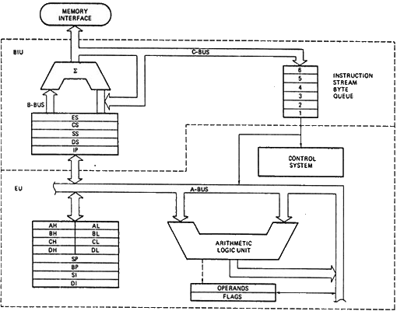
Architecture of 8086 microprocessor:

Slide 5
8086 has two major functional unit:
Bus Interface Unit(BIU)
Execution Unit(EU)
BIU and EU are connected with the Internal Bus.
Bus Interface Unit (BIU):
handles all transfers of data and addresses on the buses for the execution unit.
The BIU sends out addresses, fetches instructions from memory, reads data from ports and memory, and writes data to ports and memory.
It has the following functional parts:
Instruction queue
To increase the execution speed, BIU fetches as many as six instruction bytes ahead to time from memory.
All six bytes are then held in first in first out 6 byte register called instruction queue.
Then all bytes have to be given to EU one by one.
This pre fetching operation of BIU may be in parallel with execution operation of EU, which is called pipelining.
Pipelining improves the execution speed of the instruction.

Slide 6
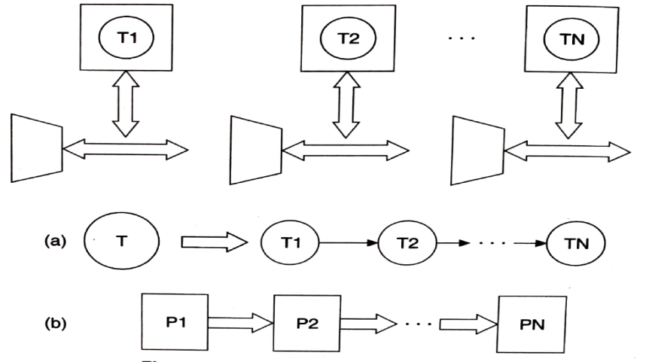
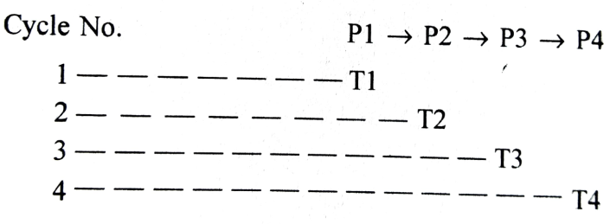
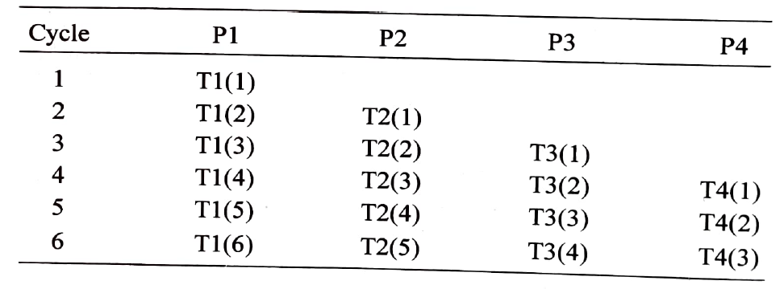
pipelining

Slide 7
Segment register
8086 has a concept of Memory Segmentation, a method where the whole memory is segmented (divided) into smaller parts called segments.
It is basically used to enhance the speed of execution of the computer system, so that the processor is able to fetch and execute the data from the memory easily and fast.
The 1 MB(2²⁰) memory is divided into 16 sections each containing 64 KB memory locations.
At one time we can work with 4 sections or segments.
The segments are
• Code Segment
• Stack Segment
• Data Segment
• Extra Segment

Slide 8
Code Segment:
It is used to store instruction code of a program.
Data Segment:
It stores data bytes or words.
Stack Segment:
It is used to store stack of data used in PUSH/POP operation.
Extra Segment:
ES is an additional data segment, which is used by the string to hold the extra destination data.

Slide 9
BIU has 4 segment registers i.e. CS, DS, SS& ES, corresponds to Code Segment, Data Segment, Stack Segment and Extra Segment respectively.
Each register is 16 bit long.
The segment registers hold the higher-order16 bits of 20-bit memory addresses of the corresponding segment (Base Address).
As the four LSBs of base address are always 0H or 0000(binary), the Base Address of each segment can be generated by appending four 0’s at the end of segment register content.
All memory addresses (Physical Address) of 8086 are computed by summing the contents of the segment register(Base Address) and Offset address.
Physical Address=BaseAddress+OffsetAddress
Instruction pointer
It is a 16-bit register used to hold the address of the next instruction to be executed.

Slide 10
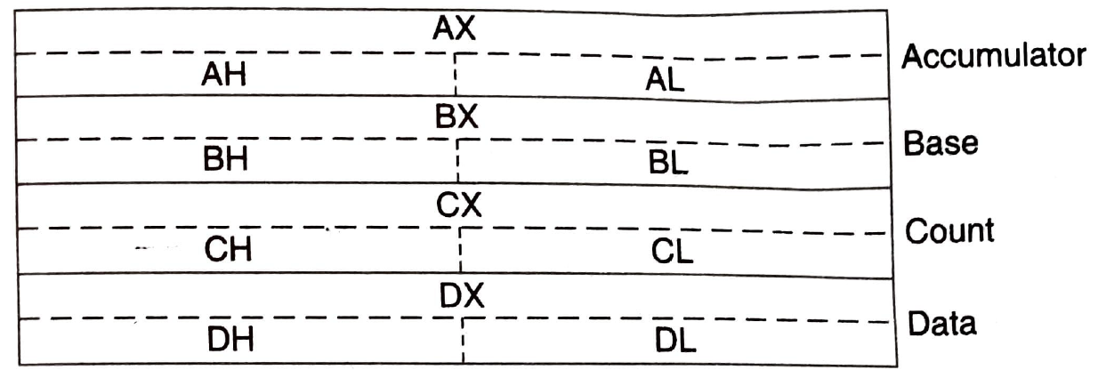
Execution Unit
The main functions of EU are:
To tell BIU where to fetch the instructions or data from.
Decoding of Instructions
Execution of instructions
Functional Parts:
General Purpose Registers/Data Registers
It has four 16-bit data registers.
Also they are treated as eight 8-bit registers.
These registers can be used as 8-bit registers individually or can be used as 16-bit in pair to have AX, BX, CX, and DX.
AX Register:
Also known as accumulator register.
It stores operands for arithmetic operation like divided, rotate.
16 bit operand and result stored in AX
AL is used for 8-bit operations.
In 32 bit multiply and divide instruction, AX holds the lower-order operand.
BX Register:
It is a general purpose data register.
When ever any memory location is selected to store/retrieve the data , the address location is stored inside BX.

Slide 11
CX Register:
It is primarily used to store count(desired no of repetitions) in multi iteration instruction and automatically decremented after each instruction.
When it becomes zero, the execution of instruction is terminated.
DX Register:
DX register is used in I/O instruction ,multiply and divide instruction.
DX contains the address of I/O ports in certain type of I/O instructions..
In 32 bit multiply and divide instruction, DX holds the higher-order operand.

Slide 12
Pointer and Index Register Group
These registers generally stores offset(Effective Address).
Also they are used as general purpose registers.
Stack Pointer(SP)
Base Pointer(BP)
Source Index(SI)
Destination Index(DI)
Instruction Pointer(IP)
Stack Pointer(SP) and Base Pointer(BP)
The value of SP represents the offset of the next stack location in SS(points to the top of the stack)
The complete address is formed by adding the content of SS(Stack Segment Register), after 4-bit left shift, to the SP.
The value of BP register represents the offset of starting memory location of stack memory management.
It provides indirect access to data in stack register.
Source Index(SI)/Destination Index(DI)
It stores offset for data segment.
Instruction Pointer
It is also referred as Program Counter.
It contains offset for Code Segment.

Slide 13
Q1. If CS=3000H, IP=0500H. Find the Physical Address.
Ans: Base Address(BA)=30000H
Physical Address(PA)= BA+IP
=30000H+0500H
=30500H
Q2. What is the maximum amount of memory thatcan be achieve at a given time in the 8086 .
Q3.What do SI and DI stands for?
Q4. What is the difference between SI and DI.

Slide 14
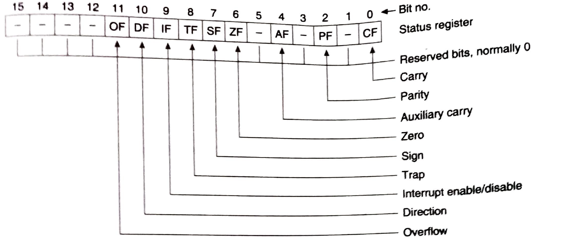
Flag Registers
Flags Register determines the current state of the processor.
It is also known as Program Status Word.
8086 has 9 flags and they are divided into two categories:
Conditional Flags
Control Flags

Slide 15
Conditional Flags
It has 6 conditional flags.
Carry flag(CF) − This flag indicates an overflow condition for arithmetic operations.
Parity flag(PF) − This flag is used to indicate the parity of the result, i.e. when the lower order 8-bits of the result contains even number of 1’s, then the Parity Flag is set. For odd number of 1’s, the Parity Flag is reset.
Auxiliary flag (AF)− When there is a carry/barrow from lower nibble (i.e. D0 – D3) to upper nibble (i.e. D4 – D7), then this flag is set, i.e. carry given by D3 bit to D4 is AF flag. The processor uses this flag to perform binary to BCD conversion.
Zero flag(ZF) − This flag =1, when the result of arithmetic or logical operation is zero else it is set to 0.
Sign flag(SF) − This flag holds the sign of the result, i.e. when the result of the operation is negative, then the sign flag is set to 1 else set to 0.
Overflow flag(OF) − This flag represents the result when the system capacity is exceeded.

Slide 16
Control Flags
It has 3 control flags.
Control flags controls the operations of the execution unit. Following is the list of control flags −
Interrupt flag(IF) −
It is an interrupt enable/disable flag.
It is set to 1 for interrupt enabled condition and set to 0 for interrupt disabled condition.
Direction flag(DF) −
It is used in string operation.
When set, it causes the string to auto decrement(process string from right to left) otherwise the string process from left to right.
Trap flag(TF) −
It is used for single step control and allows the user to execute one instruction at a time for debugging.
If it is set, then the program can be run in a single step mode.

